Slide 1

Tag Subscription
January 2017

Slide 2
Agenda
Overview of New Tag Subscription
Enhancements
High-Level Numbering Guidelines
Store Mapping
Aisle/Section Labels
Completed Subscription – 4ft section
New ISP Tag Subscription screens
New Handheld Tag Subscription screens
Request Labels examples with view section printout
Tag Aisle/Section/Shelf examples
Demo of the New Tag Subscription Screens
Walk-through 7 HH screens
Walk-through 3 ISP screens
3. Review questions or comments from the group

Slide 3
Functional Bridge
Function | Q1/2016 Conversions | Post-conversion
Subscription Maintenance | Prototypes - complete | Handheld capability improvements
Tag Printing | Subscription data printing on tag - complete | Enhance for multiple locations – complete
Batch Printing | Print Aisle and Section in sequence order - complete | n/a
Tag Suppression | Suppress items that are not subscribed - complete | Review auto-suppression opportunities

Slide 4
Tag Subscription Implementation
High-Level Numbering Guidelines for Store Mapping
001 – 099 Designated aisles in Grocery,
Frozen, Dairy, GM/HBC
500 – 549 Meat
600 Front Checkout Pallet Drops
201 – 249 Natural Foods
601 – 697 Checkout Lanes
300 Produce
698 – 699 Customer Service
350 Floral
700 Pharmacy
351 Greenhouse
800 Liquor
400 Bakery
900 Wall of Values
450 Deli

Slide 5
Mapping
Check out 1
Check out 2
Check out 3
Check out 4
601
602
603
604
Typical
Store
Layout

Slide 6
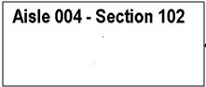
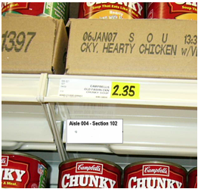
Aisle-Section Labels
Aisle-Section Labels identify all mapped sections
Every 4’ shelf section or every warehouse rack section
(except cosmetics which may be by Mfg. rack)
Every freezer door
Every 4’ section of coffin case

Slide 7
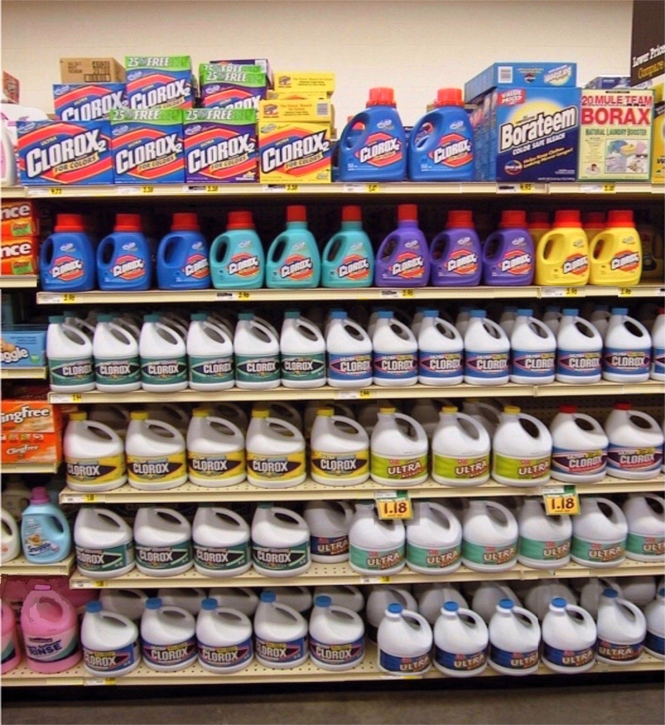
Completed Subscription of 4’ Section
“X’s” in
next
section
4’ Section
12
13
14
15
16
17
X
9
10
11
7
8
X
5
6
3
4
1
2

Slide 8
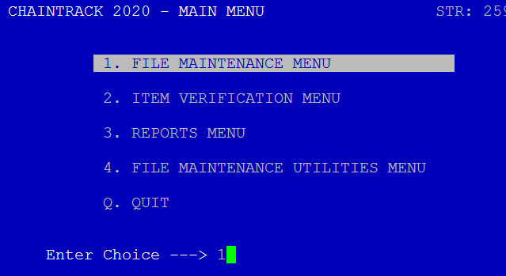
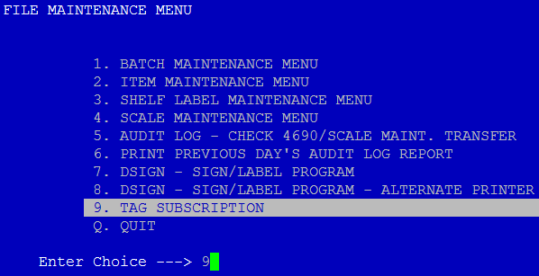
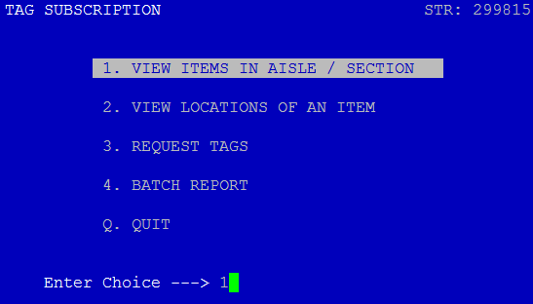
ISP Screen Shots
Main Menu
File Maintenance Menu
Tag Subscription Menu
The main 4 options on the ISP for Tag Subscription
View Aisle/Section
View specific item location
Request Tags
Batch Report

Slide 9
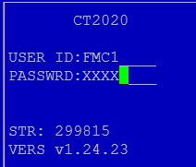
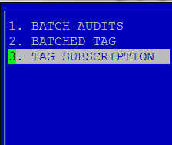
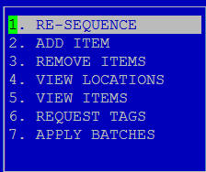
Handheld Tag Subscription Screens
There are 7 menu options on the Handhelds
Re-Sequence a specific section
Add items to a section
Remove Items from a section
View specific UPC Aisle/Section/Shelf location
View all items in a specific Aisle/Section location
Request a set of tags for a range of Aisle/Section locations
Apply Aisle/Section/shelf values from the Handheld to the ISP

Slide 10
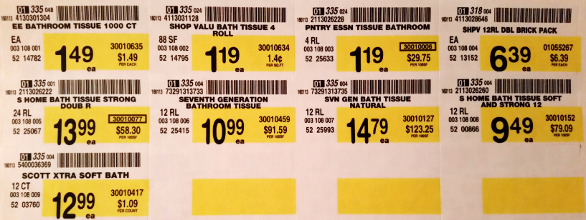
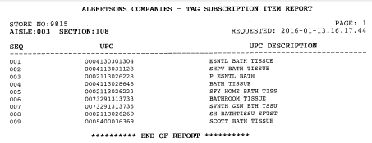
Medium Retail Tags

Slide 11
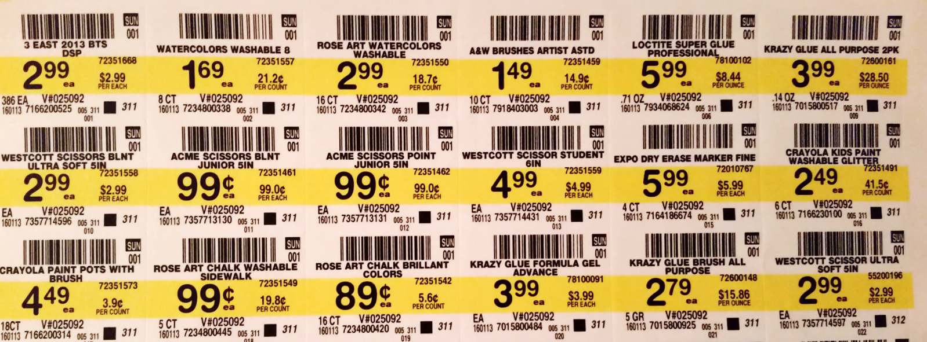
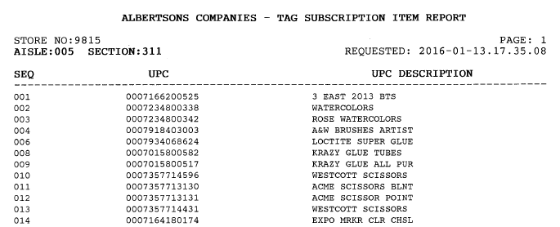
Small Reg. Retail Tags

Slide 12
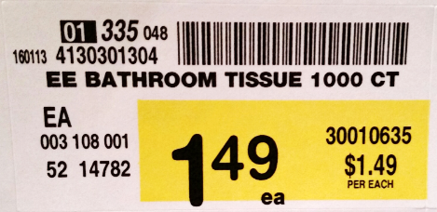
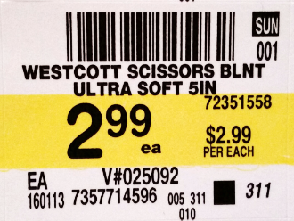
Example of Aisle/Section/Shelf
This item is located on Aisle 003 - Section 108 – Shelf 001
This item is located on Aisle 005 - Section 311 – Shelf 010

Slide 13
Questions or Comments?

